Slide 1

Office of the Dean of Students
Missouri University of Science and Technology
Upholding community standards and supporting holistic student success.
August 7, 2024

Slide 2
Dean of Students Office
STUDENT CONDUCT
Responding to academic and non-academic misconduct.
S&T VALUES
Promoting S&T Values & upholding community expectations.
STUDENT DEVELOPMENT
Providing opportunities for students to learn, grow, & develop.
RISK MANAGEMENT
Risk management consultations and support.
Notes:
We promote community standards, health, welfare, and safety, and student development through educational programs and processes designed to resolve conflict and violations of institutional policies
Our office balances the complex, interconnected goals of remaining community-focused, learning-centered, and procedurally sound (Gehring, 2001; Pavela & Pavela, 2012).
We are here to help students navigate their S&T experience by providing a safe and healthy campus environment of integrity.

Slide 3
Purpose of Standards
Maintain health, safety, and welfare
Ensure accountability and credibility of the S&T degree
Foster integrity, academic success, Development, and responsible citizenship
Notes:
When an institution is infused with integrity, we create a stronger civic culture as a whole

Slide 4
Conduct Referral Process
Evaluate &
Assess
Collaborate
Determination
Issue a Disposition
Engage the Student
Monitor Completion
Notes:
The CRRs state that those made aware of violations shall refer them.

Slide 5
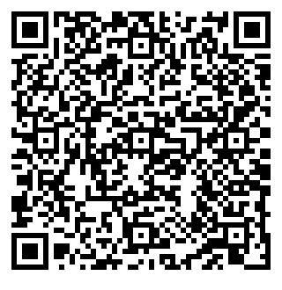
How to Report Non-Academic Misconduct
https://cm.maxient.com/reportingform.php?UnivofMissouriSystem&layout_id=9
Submit as much information as possible:
Complete description of the incident
Incident date and time
Allegation summary
Does it involve a student or organization?
Other evidence or documentation
      Email dos@mst.edu

Slide 6
Example Non-Academic Standards
Substantial Disruption of class, lab, or research
Forgery or Furnishing False Information
Direct Threats – serious intent of unlawful violence
Theft, unauthorized possession, or safety hazard
Alcohol or Drugs
Failure to Comply
Technology Misuse
If you’re not sure – we are happy to consult.
  See full Standard of Conduct

Slide 7
Responding to Classroom Disruption
Threats or crisis call 911
Ask the student to cease the behavior
Have a private conversation with the student
Follow-up in writing on expectations and consequences
Consult with your GTA Coordinator or Chair
Maintain documentation – issues, efforts, communications
Refer students who fail to comply
Threats or crisis call 911

Slide 8
What Is Academic Integrity
Academic Integrity
Honesty
Trust
Fairness
Respect
Courage
Commitment to six fundamental values.
Responsibility
Notes:
The goals of teaching, learning, research, and service can only be accomplished in ethical environments.
S&T’s mission to integrate education, research and application to create and convey knowledge to solve the world’s great challenges can’t be fulfilled without a commitment to these six fundamental values: honesty, trust, fairness, respect, responsibility, and courage.
By embracing these fundamental values, collectively we create effective scholarly communities where integrity is a foundation. Without them, our work loses value and credibility.
So how do we do that?
Faculty demonstrate honesty at the organizational level to set the tone for the overall academic endeavor
Faculty promote trust by setting clear guidelines for assignments and for evaluating student work in an equitable manner.
We demonstrate fairness through impartial treatment and consistent response
Faculty show respect by recognizing students as individuals, helping them develop, and providing honest feedback
Responsible faculty not only create and enforce classroom and institutional policy, but they also clearly communicate expectations
Courage manifests itself as the willingness to hold ourselves and others accountable for maintaining a culture of integrity and upholding these values
These fundamental values serve to inform and improve ethical decision-making capacities and behavior, they enable us to translate ideals into action where our community will flourish from living these fundamental values.

Slide 9
Types of Academic Dishonesty
Cheating
Plagiarism
Sabotage
Unauthorized use of artificially generated content

Slide 10
Academic Misconduct
Pressure
Perception
Lack of Preparation
Lack of Clarity
Courseload
Personal Characteristics
Why Students Cheat

Slide 11
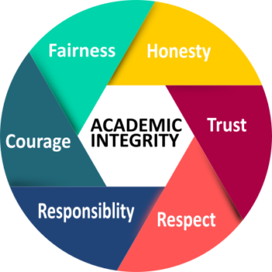
Why Submit An Academic Dishonesty Report?
Course and Curricular Integrity
Maintain Accountability
Properly Address
Consistent with CRRs
The wheel of academic integrity (image credit: Briana Fraser)
Notes:
Maintain Course and Curricular Integrity
Increase Student and Faculty Accountability
Initiate Corrective Action for Repeat Offenders

Slide 12
Steps for Reporting Academic Misconduct
Discuss incident with GTA Supervisor
Make an academic judgment about that work
Follow the syllabus
Talk with the student about the incident
Submit a report to the Dean of Students Office
Aligned with CRRs
Notes:
Consult department chair if necessary
Align with syllabus - cheating, plagiarism, and/or unauthorized use of artificially generated content

Slide 13
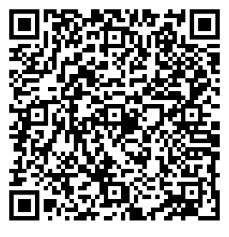
How to Report Academic Misconduct
https://cm.maxient.com/reportingform.php?UnivofMissouriSystem&layout_id=39
Submit as much information as possible:
Complete description of the incident
Incident date and time
Allegation summary
Course name, number, section
Course syllabus
Assignment instructions
Work/assignment in question
Other evidence or documentation
      Email dos@mst.edu

Slide 14
Informal Procedure Overview
University Response is separate from instructor response
Instructor receives e-verification of case submission
Investigation and Disposition (Informal or Formal)
Sanctions may include:
Warning, Lose of privileges. Remedial/Corrective Course or Workshop. Probation. Suspension, Dismissal, Expulsion

Slide 15
Tips and Recommendations
For GTAs and Instructors
Infuse integrity into curriculum
1
Discuss academic integrity often
2
Include a syllabus statement
3
Discuss possible consequences.
4
Utilize Turnitin
5
Report suspected violations.
6
Model integrity, be consistent.
7
Notes:
E.G. - creating outlines not reports.
Within the context of the course and its limitations.
Detection tools may not automatically lead to academic dishonesty.

Slide 16

AI & Academic Integrity
Steps to Support Student Success
  Create an AI policy for your course.
  Consult with GTA supervisor.
  Clarify what can be used and when.
  Show students how to properly use AI.
  Remember detection tools are flawed.
by Information technology
Notes:
E.G. - creating outlines not reports.
Within the context of the course and its limitations.
Detection tools may not automatically lead to academic dishonesty.

Slide 17

You Play a Critical Role
Maintaining and promoting a safe and healthy campus culture of integrity
Maintain:
Your Integrity
Course Integrity
Department Integrity
University Integrity
Notes:
17

Slide 18
Nick Bodkins
Student Conduct Manager
Questions?
dos@mst.edu

